Slide 1
Biweekly Meeting for RL Based Truck&Trailer Project
March 17 2023

Slide 2
Recently Updates
Finish integrating of truck trailer model into gym framework
Conduct Training of Truck Trailer model with different constraint and reward function
Found the target conference
Finish the initial structure of our paper and abstract part

Slide 3
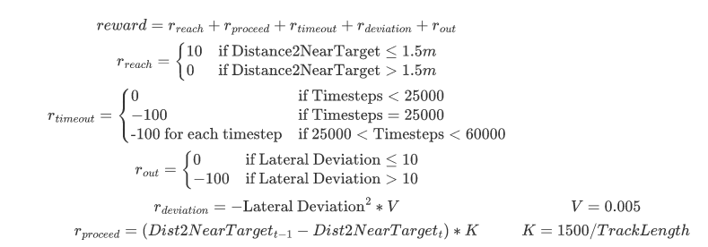
Reward function revision

Slide 4
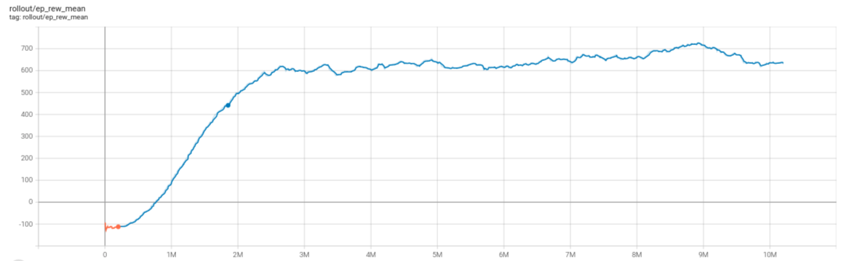
Training Results of function deviation reward on Bus Model

Slide 5
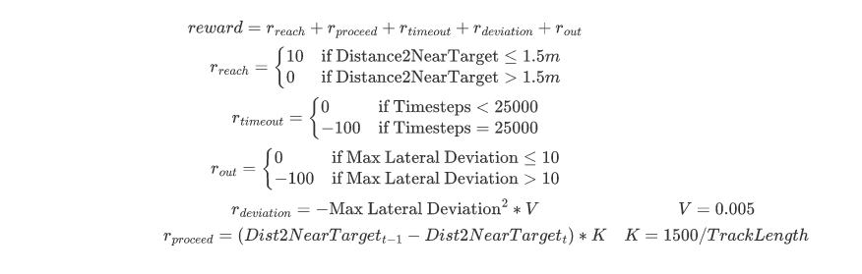
Constraint Revision on Truck Trailer Env

Slide 6
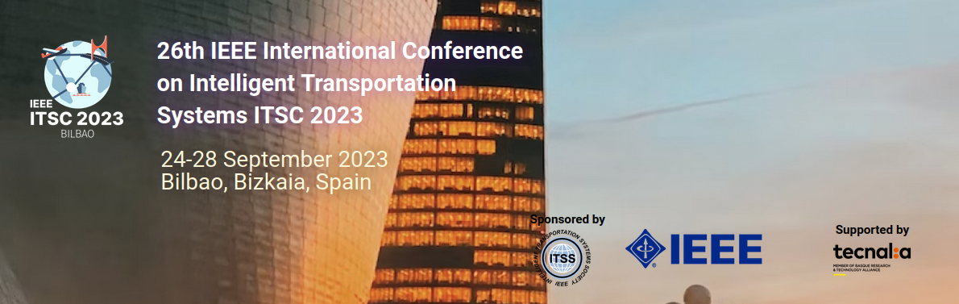
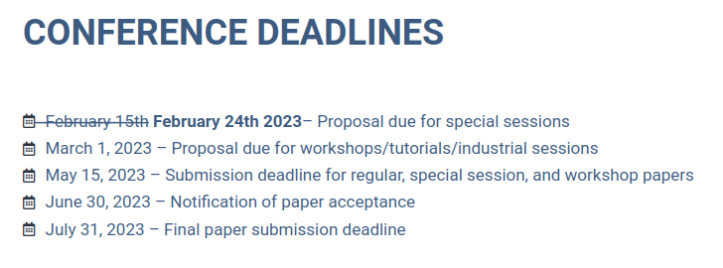
Conference detail

Slide 7
Structure of the paper
Introduction
Background
Truck Trailer control
Deep reinforcement learning
Problem Formulation
Simulator and models
B-spline path generation
Truck trailer kinematics
Methodology
State
Action
Reward function
Constraints and termination condition
Simulation Results
Conclusion

Slide 8
Plans for next two weeks
Design experiments on different reward function and constraint condition
Fix Zigzag problem
Finish the introduction part of the conference paper

